Slide 1
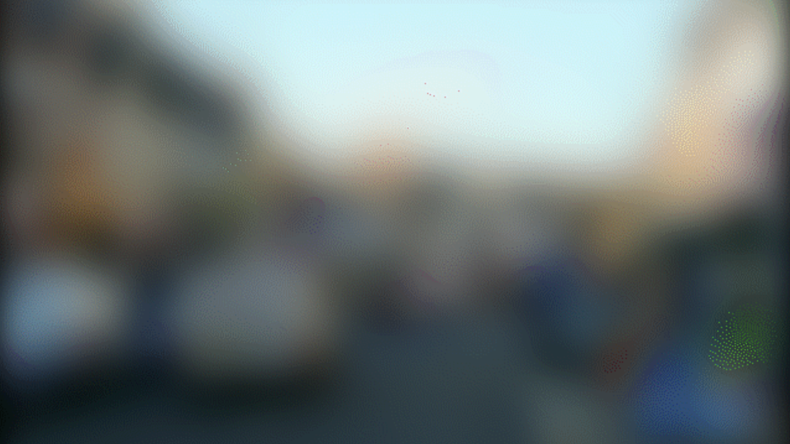
Notes:
Imagine seeing the world like this. Or actually, not seeing it.

Slide 2
STATE OF PLAY
The number of blind people across the world is set to triple within the next three decades.
2019
2050
550 million
200 million
Notes:
Globally, there are more than 200 million people with moderate to severe vision impairment.
That figure is expected to rise to more than 550 million by 2050.
The number of blind people across the world is set to triple within the next four decades

Slide 3
Sound is a key to immersion in the world around us.
Notes:
Acoustic feature is one of the physical properties of the material world.

Slide 4
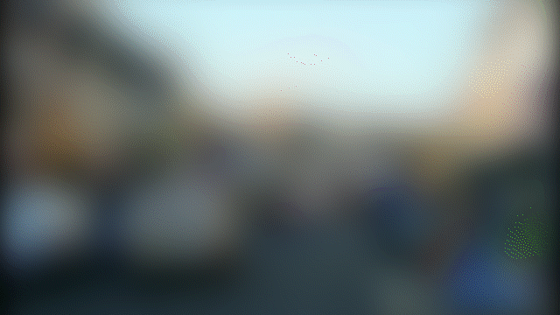
We make
the invisible visible
Notes:
Mental mapping of spaces, and of the possible paths for navigating these spaces, is essential for the development of efficient orientation and mobility skills. Most of the information required for this mental mapping is gathered through the visual channel. Blind people lack this crucial information and in consequence face great difficulties (a) in generating efficient mental maps of spaces, and therefore (b) in navigating efficiently within these spaces.

Slide 5
OBJECTIVE
We make
the invisible visible
Notes:
To help the visually impaired to perceive the world by leveraging the power of soundscape design.
To engage the people with the surroundings in everyday life by allowing them to interact with all material they can see.

Slide 6
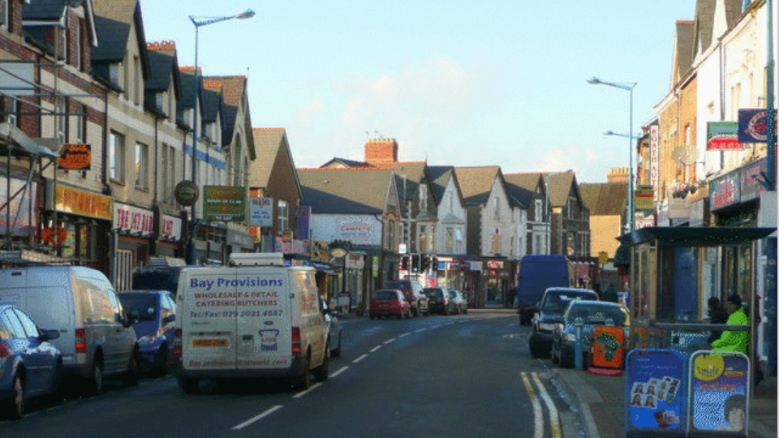

Slide 7
WHAT WE DID
spatial sound designer
nigel
ios developer
acoustic researcher
creative designer
Notes:
We are a creative team with multiple talents.
Together, with the help of L-isa, Audio Commons, and many many mentors supporting us here in the past 24 hrs
we Turned the world we “see”

Slide 8
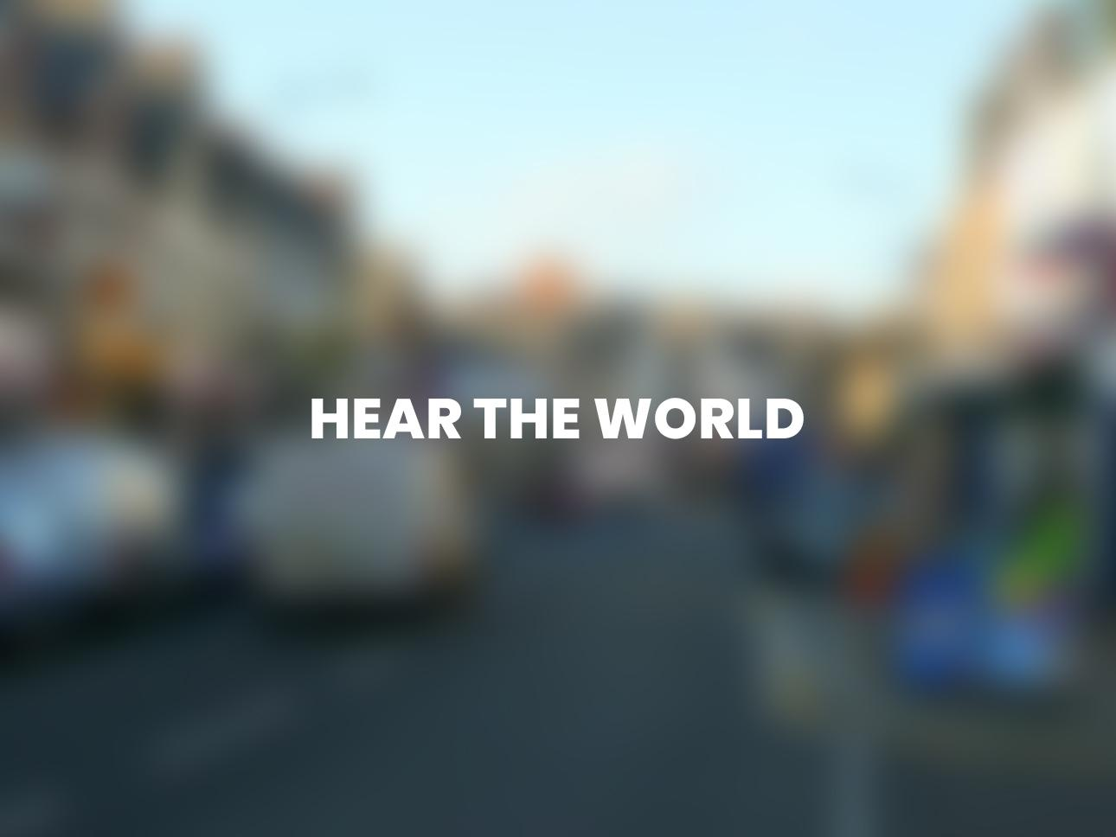
Notes:
into a sonified space.
Our interface ‘Hear the World’ | is realised by Detecting scenes and objects from the images

Slide 9


IMAGE ANALYSIS → SOUND RETRIEVAL → SPATIALISATION
Notes:
retrieving sounds from the open-source libraries | using the keywords extracted
And finally, mapping the sounds we’ve retrieved | to a 3D space.

Slide 10
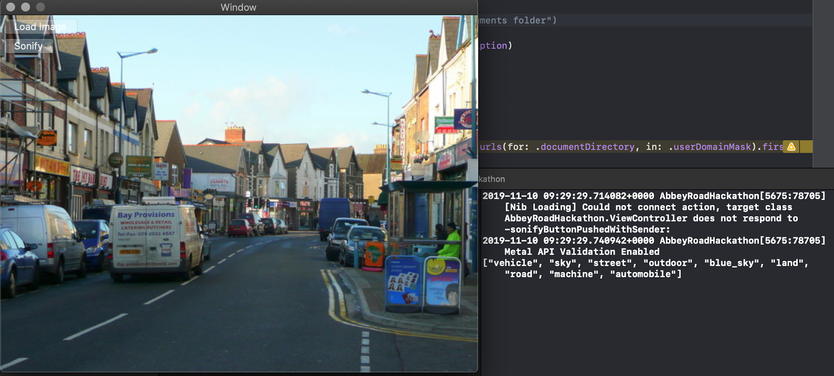
Notes:
We currently have a mac app that finds relevant audio files for the images. Categories identified in this image are vehicle, sky, street ect. These are files are pulled from free sound.

Slide 11
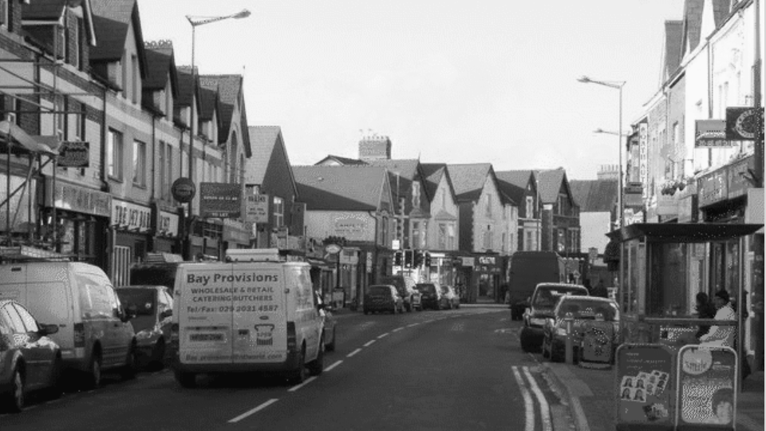
HOUSES
PEOPLE
HOUSES
Notes:
We would like to develop this further with object localisation

Slide 12
{ "object": "house",
"size": 1,
"distance": 353.71,
"position": 1138, }
Notes:
This could then pair sounds with location metadata
1:41’

Slide 13
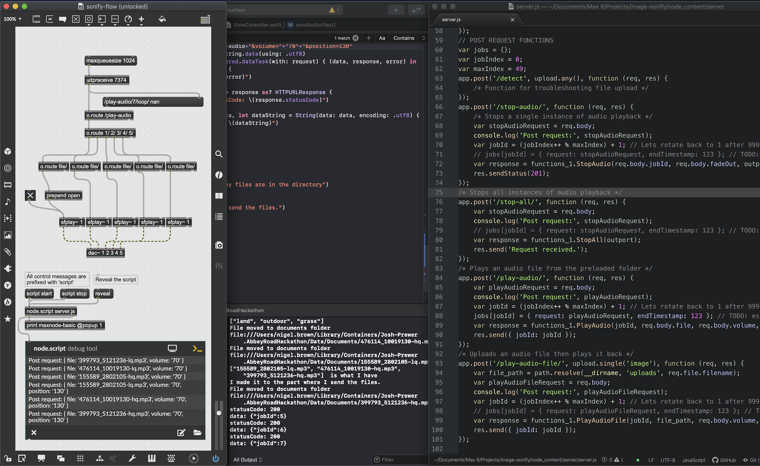
Notes:
2:45

Slide 14
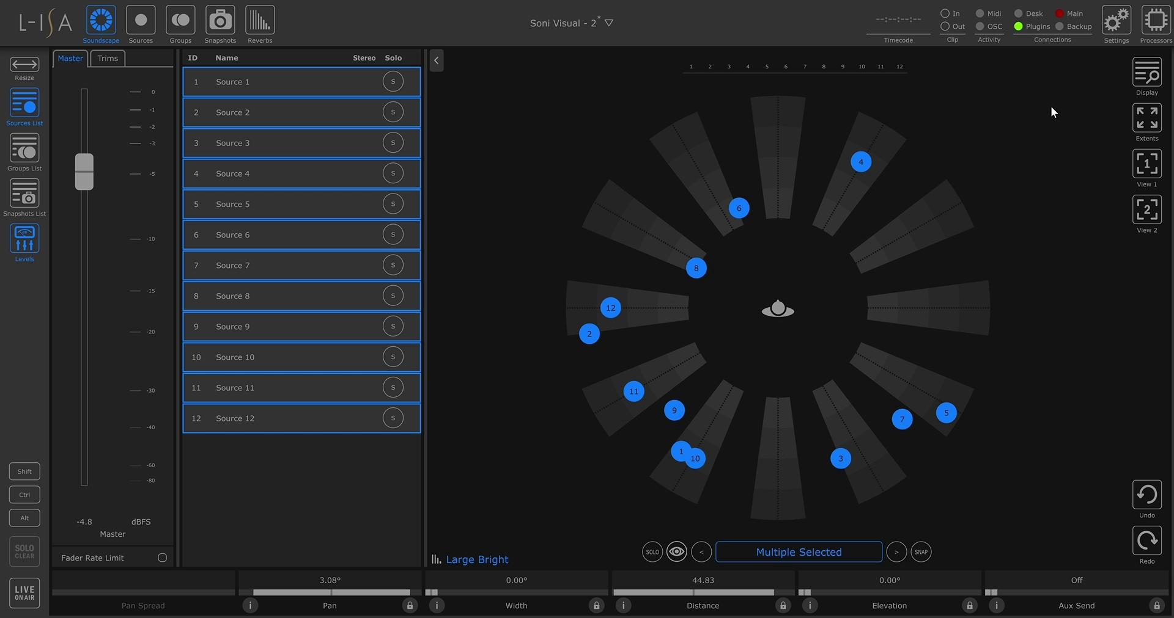
Notes:
3:05
3:15

Slide 15
Potential
Push the boundaries of sensory experience.

Slide 16
THANK LIST
TEAM
Nigel Brown
Scott Marshall
Kinga Nowicka
Joshua Prewer
Pheobe Sun
Special thanks to
Frederic, Guillaume, Anatole, Milo, Mathieu, George, Jannik, Petar, Ari, Hash, Dom, Amy

